Slide 1
Crypto Dashboard API
Project by Rafal and Lucien

Slide 2
Cryptocurrency Dashboard Introduction
This Python application built with Flask and various other libraries like sqlalchemy and panda is designed for a cryptocurrency trading platform. It integrates with the Binance API to fetch live cryptocurrency data.
01
It allows users to register, perform buy/sell transactions, and view their transaction history and portfolio value.
02
This application is intended as a backend service for a cryptocurrency trading platform where users can manage their accounts, perform transactions, and track their investments over time. It handles both the logic and data storage needed for such a platform.
03

Slide 3

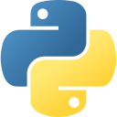


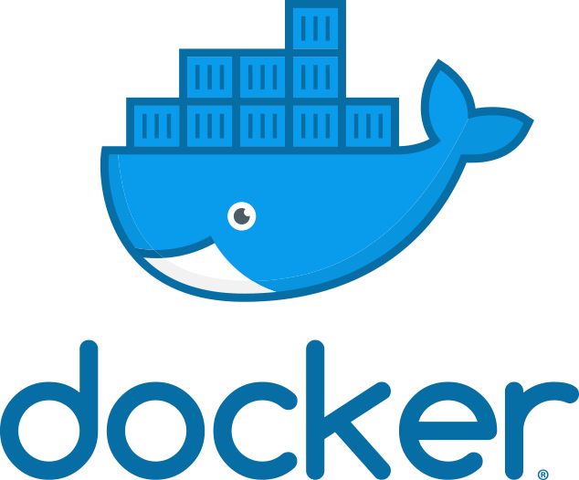





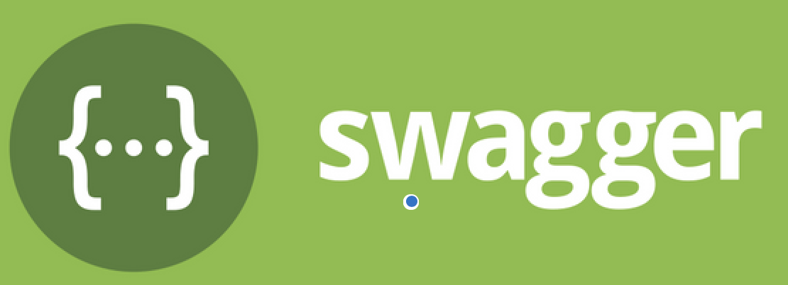
Technologies Stacks
Backend:
DevOps:
SoCat

Slide 4
Roles and Responsibilities
Rafal (BackEnd)
Primary responsibility is to design, develop, and maintain the backend logic and API endpoints of the application.
Lucien (DevOps)
Primary responsibility is to handle the infrastructure, deployment, and operational aspects of the application.
Key contributions:
API Development: Created the Flask-based API endpoints that handle user registration, user updates, transactions, and portfolio management.
Database Integration: Implemented the logic for interacting with the MySQL database using SQLAlchemy, including managing tables, executing queries, and creating relationships between data models (e.g., users, transactions, portfolio).
Key contributions:
Environment Setup: Managed the setup of the development and production environments, including configuring .env files to securely store sensitive information like API keys and database credentials.
Database Configuration and Migration: Set up the MySQL database, handled table creation, and ensured that the correct triggers and indexes were in place for efficient operations.
Together, we ensure that the application is both functionally sound (backend) and operationally stable (DevOps), allowing for smooth user experiences and reliable performance.

Slide 5
Code & Demo

Slide 6
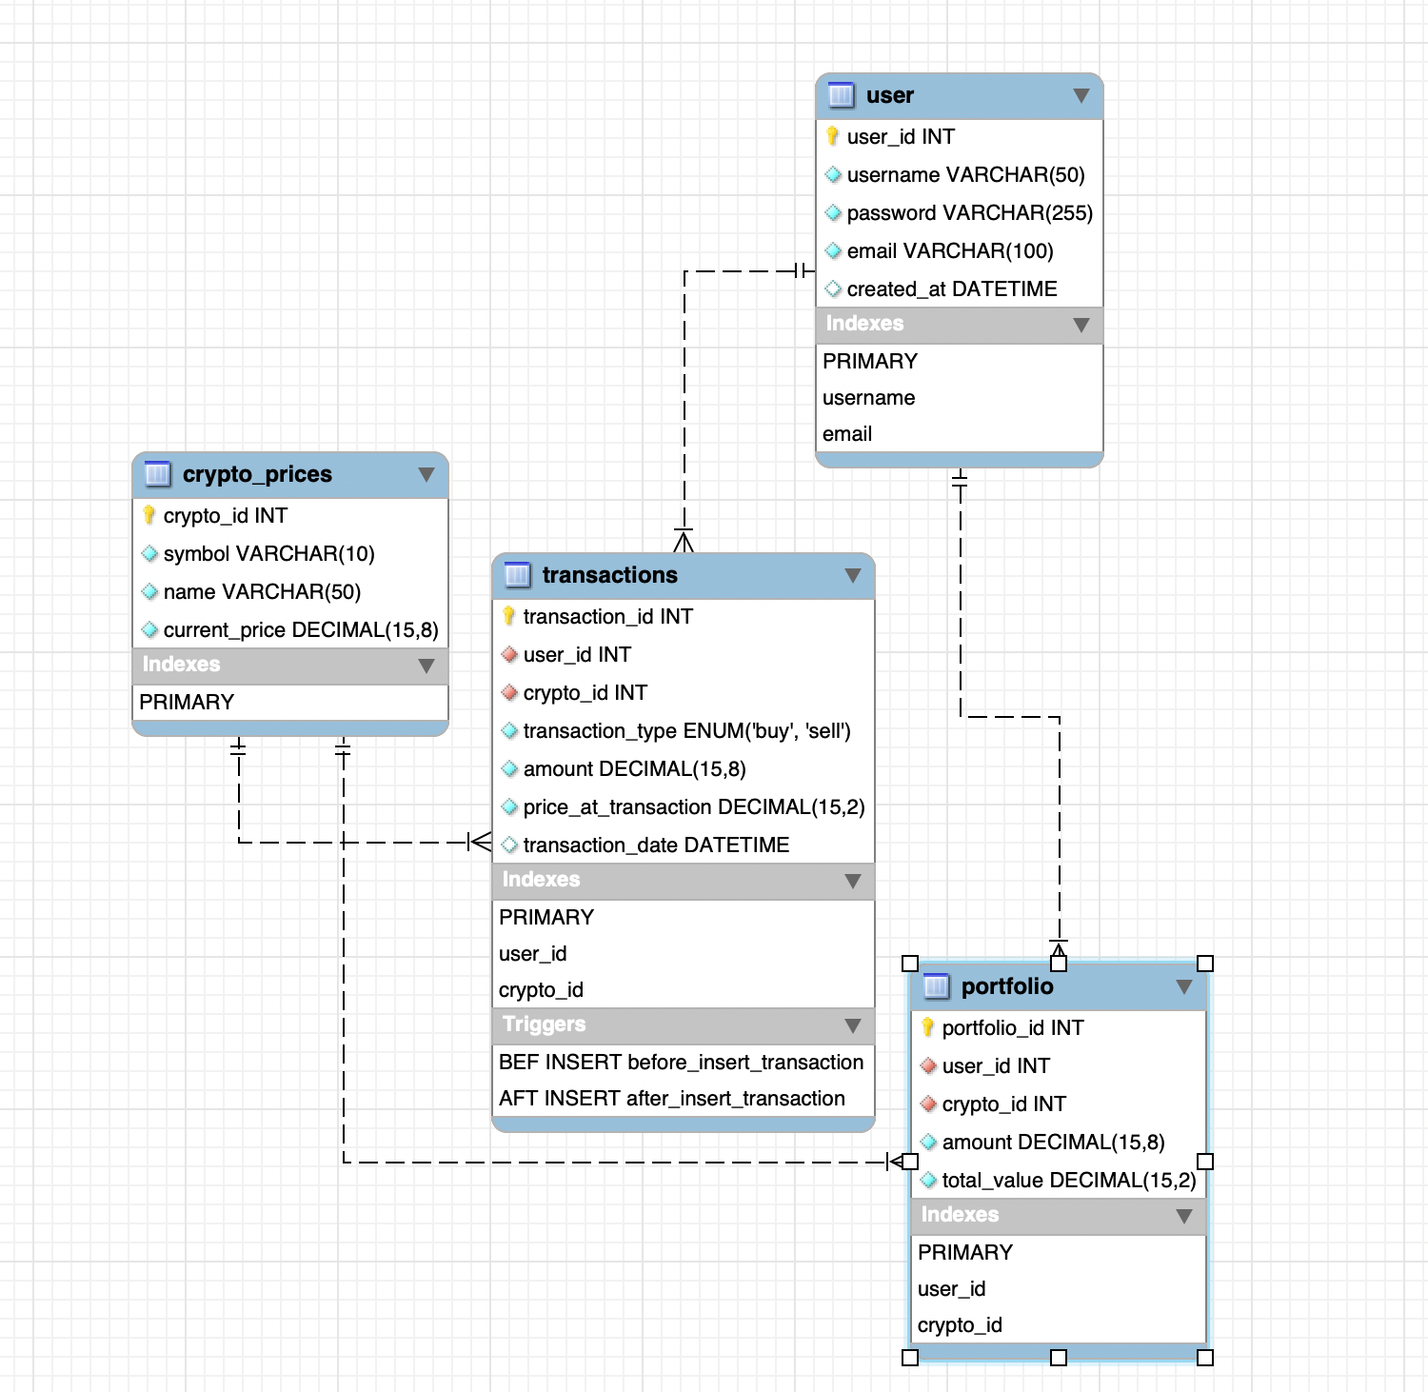
ER Diagram
3NF compliance: Atomic value, fully dependent to primary key, No transitive dependencies exist
We created two triggers:
Before_insert_transaction: take a snapshot of current the crypto price and store in the transactions
After_inser_transaction: calculate the transaction based on buy or sell. Also verification to prevent user sell over what they own on coin

Slide 7
sqlAlchemy Session
Session is like a bridge between Flask web application and database (which stores information like users, transactions, crypto prices, etc.)
Whenever a user interacts with app (like registering, making a transaction, or checking their portfolio), the session helps the app talk to the database to get or store the right information.
04
Session Setup
Closing the Session
01
03
Session Usage in CREATE, READ, UPDATE DELETE Operations
Transaction Control and Error Handling
02

Slide 8
ENDpoints
Endpoints are specific URLs in a web application that correspond to different functionalities or resources provided by the server. In the context of a Flask API, endpoints represent the routes that handle different HTTP requests (like GET, POST, PUT, DELETE). Each endpoint is associated with a particular function or operation that the API performs.
04
PUT: Update existing data (e.g., update user information).
GET: Retrieve data (e.g., get user details).
01
03
POST: Create new data
(e.g., create a new user).
DELETE: Remove data
(e.g., delete a user).
02

Slide 9
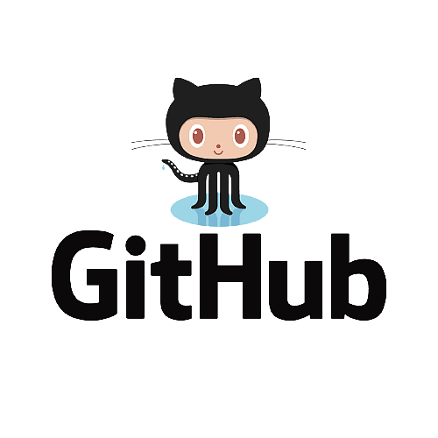
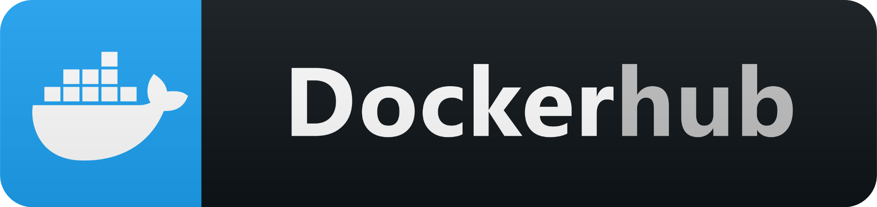
Jenkins CICD pipeline
Github “main branch”
Updated
Jenkins to build a start build new version of application image
Once build, Jenkins push it to DockerHub
Jenkinsfiles
Steps
Crypto-App
Image

Slide 10
Challenges We Faced & How We Solved Them

Slide 11
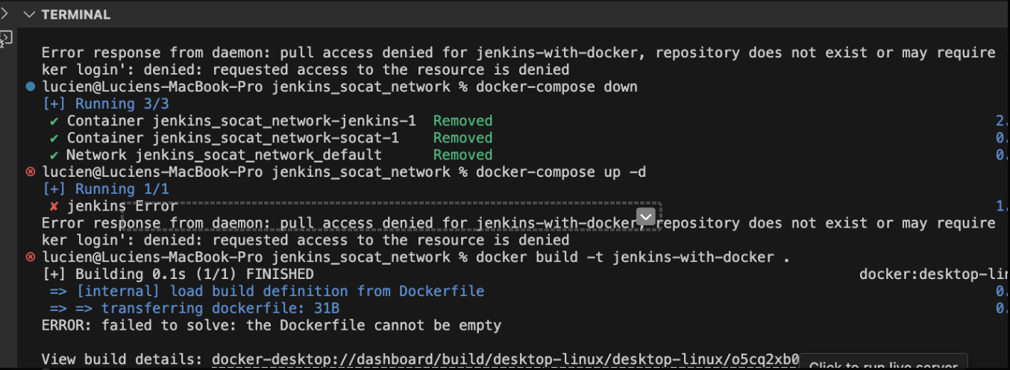
Situation: Jenkins supposed to connect github, build the docker image, and then push image to Dockerhub. However it stuck on building the docker image stage?
Error and try: (X Failed) To verify if we have install Docker inside Jenkin and this
(X Failed ) As issue is from Docker Deamon, we modify Docker Socket Permissions to Chmod 666
(X Failed) Try to solve Daemon from another angle. Rebuild Jenkins container with root privilege
(O Worked) Use socat to plug in with Docker Daemon. So container can talk to Docker Daemon

Slide 12
Docker | Jenkins | Github Connection
Docker Network
t
Public Accessible URL
websocket
SoCat
PORT 8080
For Mac:
The socat process wraps /var/run/docker.sock on the host by way of a mounted volume and exposes it in a bi-directional fashion as a TCP server to Jenkins. All without giving Jenkins more permissions.
Start a docker container based on Jenkins image
Install Docker inside of Jenkins container so Jenkins can perform docker image creation

Slide 13
Project planning, collaboration, and next steps

Slide 14
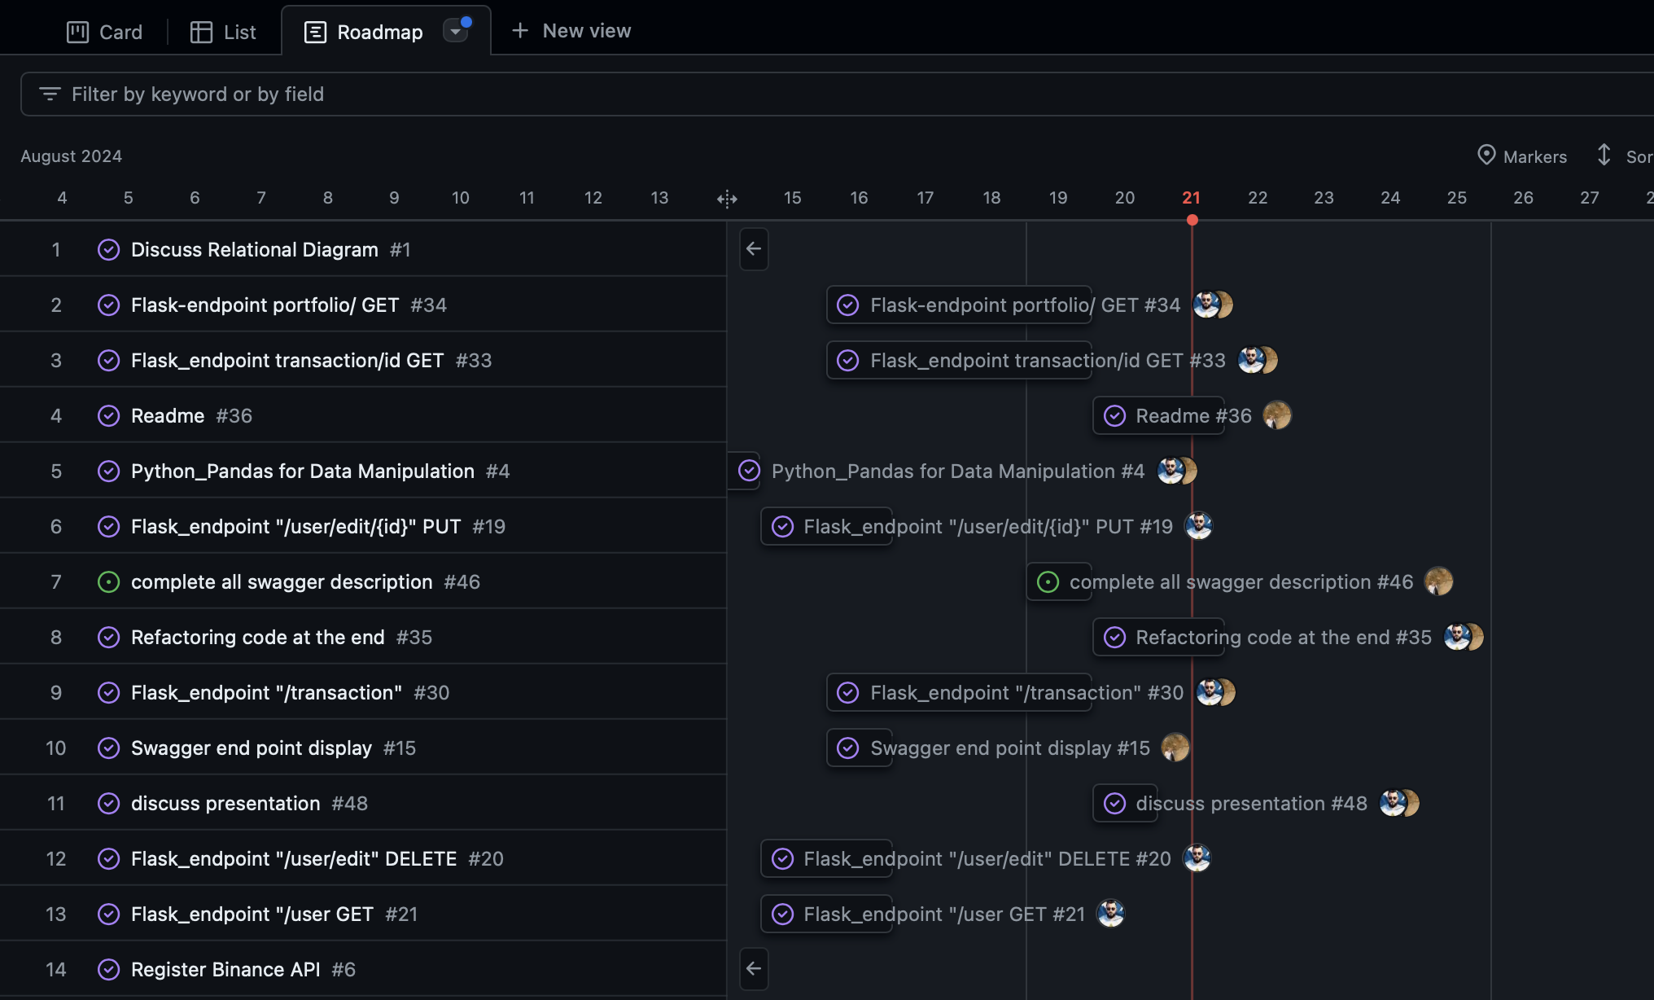
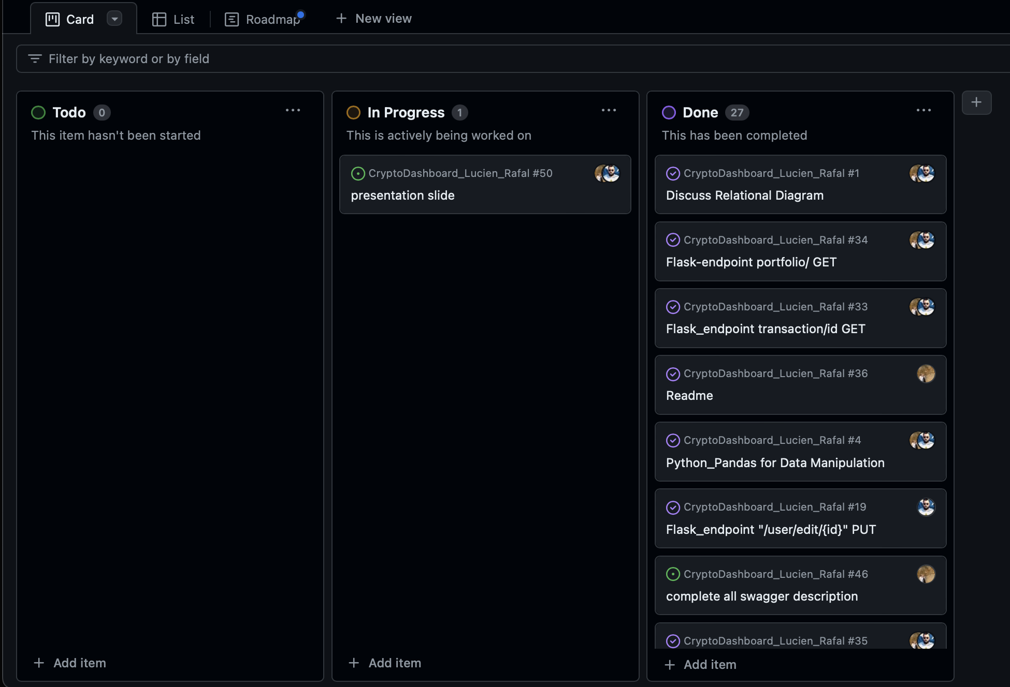
Sprint Planning and collaboration
Github Project for Sprint planning (tracking time-bounded tasks, assigning team member..)
VS Code Live Share collaboration
Microsoft Team Whiteboard for brainstorming idea

Slide 15
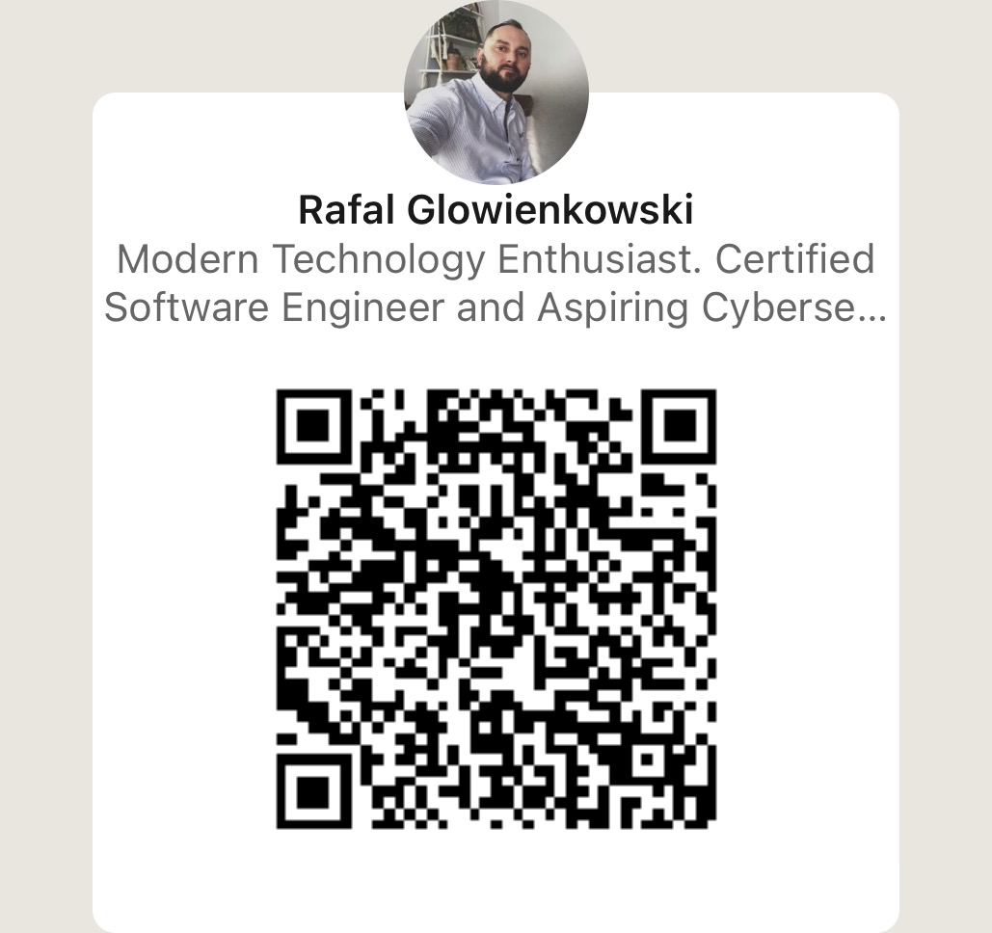
What we can improve for the future and next steps
1. Add “Fair value gap” end point by exploring further Binance API
2. Use K8s
3. Host on AWS/Azure cloud
4. Monitoring with Grafana

Slide 16
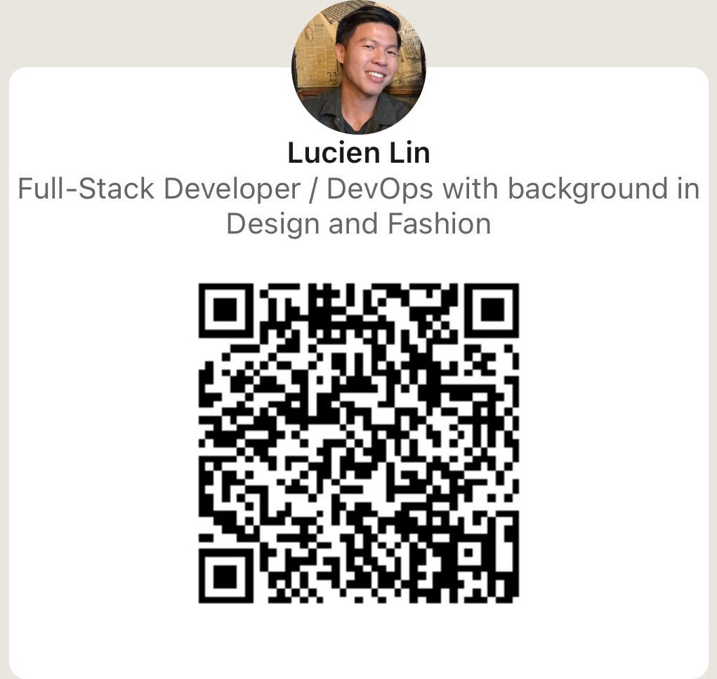

Thank you!
Connect with us!
linkedin.com/in/lucien-lin-yh/
linkedin.com/in/glowienkowski/

